Slide 1



You and Me Pre-school Prospectus
We aim to provide a relaxed, informal and friendly environment where children feel safe and happy.
Registered Charity No: 1161960
Registered as Charitable Incorporated Organisation in England & Wales

Slide 2

Welcome
Welcome to You and Me Pre-school and thank you for enrolling your child with us.
We know how important your child is and aim to deliver the highest quality of care and education to help them to achieve their best.
This prospectus aims to provide you with an introduction to the Pre-school, our routines, our approach to supporting your child’s learning and development and how we aim to work together with you to best meet your child’s individual needs. This should be read alongside our Childcare Terms and Conditions.
Helping your child to grow!
Our indoor learning environment and large secure garden set the scene for free-flow play and adventure alongside our friendly and experienced staff.

Slide 3
Our Vision
We offer high quality education and childcare in a supportive, caring and secure environment in which everyone is valued.
Value and respect all individuals.
Celebrate differences and similarities between people and cultures.
Have fun working and planning our play together.
Develop listening and communication skills to become confident communicators.
Create a life long love of learning through a broad and balanced curriculum.
Provide services for children, families and the local community.
Learn to be healthy active and safe.
Develop good manners and appropriate behaviour.
Build on strengths and nurture any identified development needs.
Motivate children to do their best and fulfil their potential.
Develop imagination, exploration, investigation, and independent thinking.
Our Aims
At You and Me Pre-school we aim to provide the best for each individual and their family. We believe children learn best through play and aim to provide an environment that supports high quality play opportunities.
Philosophy of Care
We aim to provide a caring, supportive and interesting environment for each child and provide individualised development and learning plans. These are of the utmost importance to create stability, maintain continuity and provide a good balance between flexible and structured routines, in which every child can grow and flourish.

Slide 4

Parent Partnership!
Parents and Families
You are regarded as members of our setting who have full participatory rights. These include a right to be: valued and respected;
kept informed; consulted; involved; and included at all levels.
How parents take part in the setting
Our setting recognises parents as the first and most important educators of their children. All of our staff see themselves as partners with parents/carers in providing care and education for their children. There are many ways in which parents take part in making our pre-school a welcoming and stimulating place for children and parents/carers, such as:
exchanging knowledge about their children's needs, activities, interests and progress with our staff;
contributing to the progress check at age two;
helping at sessions of the pre-school;
sharing their own special interests with the children;
being part of the Pre-school Committee;
taking part in fundraising events organised by the pre-school;
joining in community activities, in which the pre-school takes part; and
building friendships with other parents in the pre-school.
The parents' rota
Our pre-school has a dated rota which parents/carers can sign if they would like to help out at the pre-school. All you need to do is sign up! Sometimes we ask for parents/carers to join us for ‘Stay and Play’ sessions, we feel this enables parents to see what the day-to-day life of our setting is like and to join in helping the children to get the best out of their activities. Signing up for ‘Stay and Play’ is not the only means of taking part in the life of the pre-school. Parents/Carers can offer to take part in a session by sharing their own interests and skills with the children. Just see a staff member if you would like to come and share with us. We welcome parents/carers to drop into the setting to see it at work or to speak with the staff.
Find us on Facebook
Search for You and Me Pre-school, click LIKE and you will be able to follow our activities. We also post notices for events on here so no-one misses out.

Slide 5
Management of our Pre-school
Management Committee and Charity
Our pre-school is a charity and as such is managed by a voluntary management committee - whose members are elected by the parents of the children who attend our pre-school. The elections take place at our Annual General Meeting. The committee make up the registered person with Ofsted and are responsible for:
managing our finances;
employing and managing our staff;
making sure that we have, and work to, policies that help us to provide a high quality service; and
making sure that we work in partnership with parents.
The Annual General Meeting is open to the parents of all of the children who attend our pre-school. It is our shared forum for looking back over the previous year's activities and shaping the coming year's plan.
As a voluntary Committee managed setting, we also depend on the goodwill of parents and their involvement to keep going. Membership of the setting carries expectations on you for your support and commitment. The continued success of You and Me depends upon parents and friends joining our Management Committee. We are a registered Charity and this means:
NO Committee NO You and Me!
If you love what You and Me does please support the pre-school by joining the Committee.

Slide 6
Your Child’s Development & Learning
Our Approach - Learning through play
Children start to learn about the world around them from the moment they are born. The care and education offered by our pre-school helps children to continue to do this by providing all of the children with interesting activities that are appropriate for their age and stage of development. Being active and playing supports young children’s learning and development through doing and talking. This is how children learn to think about and understand the world around them. We use the EYFS statutory guidance on education programmes to plan and provide opportunities which will help children to make progress in all areas of learning. Our programme is made up of a mixture of activities that children plan and organise for themselves and activities planned and led by practitioners. Children develop and learn in different ways and at different rates. Our framework covers the education and care of all children in early years provision including children with Special Educational Needs (SEN) and disabilities. Every child is a unique child who is constantly learning and can be resilient, capable, confident and self-assured.
We aim to ensure that each child:
is in a safe and stimulating environment;
is given generous care and attention, because of our ratio of qualified staff to children, as well as volunteer helpers;
has the chance to join in with other children and adults to live, play, work and learn together;
is helped to take forward their learning and development by being helped to build on what they already know and can do;
has a personal key person who makes sure each child makes satisfactory progress;
is in a setting that sees parents as partners in helping each child to learn and develop; and
is in a setting in which parents help to shape the service it offers.
Characteristics of Effective Learning
We understand that all children engage with other people and their environment through the characteristics of effective learning that are described in the Early Years Foundation Stage as:
playing and exploring - engagement;
active learning - motivation; and
creating and thinking critically - thinking.
We aim to provide for the characteristics of effective learning by observing how a child is learning and being clear about what we can do and provide in order to support each child to remain an effective and motivated learner.

Slide 7
Early Years Foundation Stage
Provision for the development and learning of children from birth to 5 years is guided by the Early Years Foundation Stage. Our provision reflects the four overarching principles of the Statutory Framework for the Early Years Foundation Stage (DfE 2014):
A Unique Child
Positive Relationships
Enabling Environments
Learning and Development
The Areas of Development and Learning comprise:
Prime Areas
Personal, social and emotional development.
Physical development.
Communication and language.
Specific Areas
Literacy.
Mathematics.
Understanding the world.
Expressive arts and design.
For each area, the level of progress that children are expected to have attained by the end of the Early Years Foundation Stage is defined by the Early Learning Goals. These goals state what it is expected that children will know, and be able to do, by the end of the reception year of their education.

Slide 8
Your Child’s Learning Journal
We produce a Learning Journal for each child. Your child's learning journal helps us to celebrate together their achievements and to work together to provide what your child needs for their well-being and to make progress.
Your child's key person will work in partnership with you to keep this record. Together you will collect information about your child's needs, activities, interests and achievements. This information will enable the key person to identify your child's stage of progress. Together, we will then decide on how to help your child to move on to the next stage.
We assess how young children are learning and developing by observing them frequently. We use information that we gain from observations, as well as from photographs of the children, to document their progress and where this may be leading them. We believe that parents know their children best and we will ask you to contribute to assessment by sharing information about what your child likes to do at home and how you, as parents/carers, are supporting development.
Your child’s learning journal will be sent home at regular intervals for you to review but should you wish to see your child’s records at any other time, please speak to your key person. Your child’s key person will also invite you to a face to face parents evening once per academic year.
The Progress Check at Age Two
The Early Years Foundation Stage requires that we supply parents and carers with a short written summary of their child’s development in the three prime areas of learning and development - personal, social and emotional development; physical development; and communication and language - when a child is aged between 24 - 36 months. Your child’s key person is responsible for completing the check using information from on-going observational assessments carried out as part of our everyday practice, taking account of the views and contributions of parents and other professionals.

Slide 9
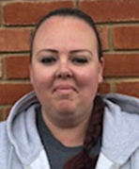
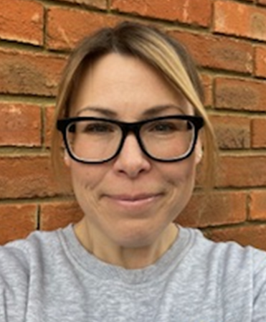
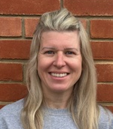
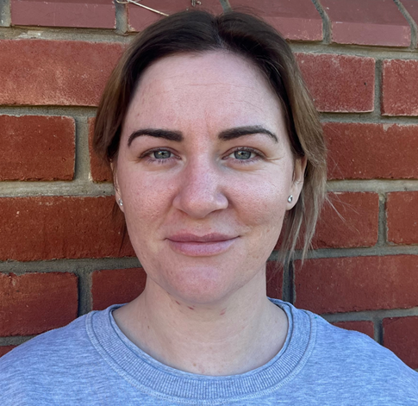
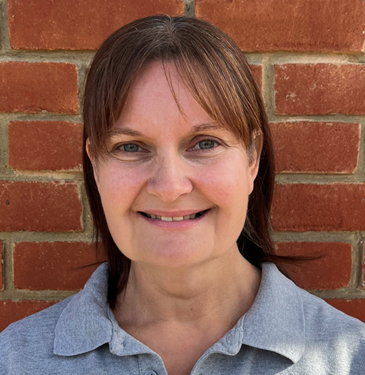

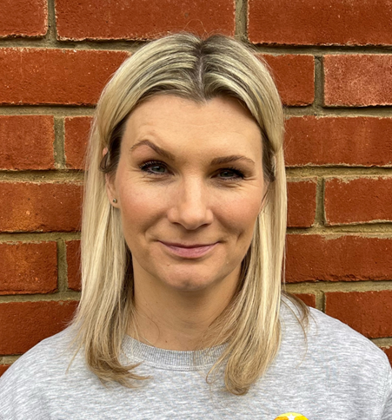
Meet Our Team
Michelle Manager |  | Emma Business Manager
Laura S Level 3 Early Years Practitioner | Zoey Level 3 Early Years Practitioner |  | Sarah Level 3 Early Years Practitioner
Heather Level 3 Early Years Practitioner |  | Laura M Level 2 Early Years Practitioner

Slide 10
Our Daily Routines
Our setting believes that care and education are equally important in the experience which we offer children. The routines and activities that make up the day in our setting are provided in ways that:
help each child to feel that they are a valued member of the pre-school;
ensure the safety of each child;
help children to gain from the social experience of being part of a group;
and provide children with opportunities to learn and help them to value learning.
Lunch and Snack Time
We make lunch and snack time a social time at which children and adults eat together. Children that attend the pre-school all day or for the afternoon session will need to bring a healthy packed lunch with them – remember we are a nut-free environment. Please tell us about your child's dietary needs and we will plan accordingly.
The Session
We organise our sessions so that the children can choose from, and work at, a range of activities and, in doing so, build up their ability to select and work through a task to its completion. The children are also helped and encouraged to take part in adult-led small and large group activities, which introduce them to new experiences and help them to gain new skills, as well as helping them to learn to work with others. Outdoor activities contribute to children's health, their physical development and their knowledge of the world around them. The children have the opportunity, and are encouraged, to take part in outdoor child-chosen and adult-led activities, as well as those provided in the indoor classroom.
Clothing
We provide protective clothing for the children when they play with messy activities. We encourage children to gain the skills that help them to be independent and look after themselves. These include taking themselves to the toilet and taking off, and putting on, outdoor clothes. Clothing that is easy for them to manage will help them to do this. You may wish to purchase our uniform to wear on pre-school days. Whilst this is not a must, it can help to save clothes and support your child’s transition to having to wear a uniform everyday for school. Uniform can be purchase from: https://myclothing.com/collections/you-and-me-pre-school-pupil-28630

Slide 11
Policy and Procedure
Policies
Our staff can explain our policies and procedures to you. Copies are available in the setting and also on our website - www.youandmepreschool.co.uk
Our policies help us to make sure that the service provided by our setting is a high quality one and that being a member of the setting is an enjoyable and beneficial experience for each child and their parents/carers.
Our staff and parents work together to adopt the policies and they all have the opportunity to take part in the annual review of the policies. This review helps us to make sure that the policies are enabling our setting to provide a quality service for its members and the local community.
Safe-Guarding
Our pre-school has a duty under the law to help safeguard children against suspected or actual ‘significant harm’. Our employment practices protect children against the likelihood of abuse in our setting and we have a procedure for managing complaints or allegations against a member of staff.
Our way of working with children and their parents ensures that we are aware of any problems that may emerge and can offer support, including referral to appropriate agencies when necessary, to help families in difficulty.
Special Educational Needs and Disability (SEND)
To make sure that our provision meets the needs of each individual child, we take account of any special needs a child may have. We work to the requirements of the Special Educational Needs and Disability Code of Practice: 0 to 25 years (2015).
Our Pre-school Designated Safe-Guarding Lead (DSL) is:
Michelle Collier
Our Pre-school Special Educational Needs Co-Ordinator is:
Sarah Drake

Slide 12
And Next …
We want your child to feel happy and safe with us. To make sure that this is the case, our staff will work with you to decide on how to help your child to settle into the setting. Our policy on the Role of the Key Person and Settling-in can be found in the Policy Pack – please ask to look at a copy.
All parents/carers are required to complete an ‘All About Me’ questionnaire (part of our New Starter Pack) before their child starts.
Your child will need:
A jumper or cardigan everyday.
A sun hat on sunny hot days.
Named water bottle (ideally filled with water) everyday.
A healthy packed lunch if staying all day or for afternoon session.
Two spare sets of clothes in a bag on your child’s peg.
A warm coat (cold days) and/or rain jacket.
Spare nappies, wipes and sacks (if still needed).
A pair of wellies on wet days (remember to pack indoor shoes!).
PLEASE NAME ALL ITEMS
Please apply sun cream before your child comes to pre-school on sunny days.
Remember to:
Phone You and Me on 01245 466535 before 9:30am, if your child is going to be absent from pre-school.
Share WOW moments from home.
Arrive on time to collect your child.
Follow us on Facebook and check the noticeboard too!
Support our fundraising events.
Join the Committee – watch out for the AGM!
Lastly …
If you wish your child to attend You and Me, please return a completed enrolment form and a non refundable £20 deposit. Copies of the enrolment form can be requested via emailing manager@youandmepreschool.co.uk
The Prospectus should be retained by you for future reference.
We hope that you and your child enjoy being members of our pre-school. Our staff are always ready and willing to talk with you about your ideas, views or questions.

Slide 13
April 2025

